Slide 1
Towards a Christian View of the World
Sessions 11 and 12
Dr. Lewis Winkler • East Asia School of Theology (Singapore) Uploaded by Dr. Rick Griffith • Jordan Evangelical Theological Seminary Files in many languages for free download at BibleStudyDownloads.org

Slide 2
Introduction

Slide 3
Some Potential Problems with the Singular Concept of a Christian Worldview:
Culture is a vital and inseparable aspect of worldview formation and utilization.

Slide 4
Some Potential Problems with the Singular Concept of a Christian Worldview:
Culture is a vital and inseparable aspect of worldview formation and utilization.
There are (and have been and will continue to be) numerous distinct cultures around the world.

Slide 5
Some Potential Problems with the Singular Concept of a Christian Worldview:
Culture is a vital and inseparable aspect of worldview formation and utilization.
There are (and have been and will continue to be) numerous distinct cultures around the world.
Of these cultures, which could definitively be called the one and only truly Christian culture?

Slide 6
Some Potential Problems with the Singular Concept of a Christian Worldview:
So, then, can we still really talk about a distinctly singular “Christian” worldview?

Slide 7
Some Potential Problems with the Singular Concept of a Christian Worldview:
So, then, can we still really talk about a distinctly singular “Christian” worldview?
No.

Slide 8
Some Potential Problems with the Singular Concept of a Christian Worldview:
So, then, can we still really talk about a distinctly singular “Christian” worldview?
No.
Yes.

Slide 9
Why Only Towards a Christian View of the World?
A perpetually perfect and godly lifestyle within the world is impossible this side of heaven.

Slide 10
Why Only Towards a Christian View of the World?
A perpetually perfect and godly lifestyle within the world is impossible this side of heaven.
The dynamic nature of both the gospel of God and human culture make a static view of the world untenable.

Slide 11
Why Only Towards a Christian View of the World?
A perpetually perfect and godly lifestyle within the world is impossible this side of heaven.
The dynamic nature of both the gospel of God and human culture make a static view of the world untenable.
God is constantly engaged in revealing Himself to the world.

Slide 12
Why Only Towards a Christian View of the World?
A perpetually perfect and godly lifestyle within the world is impossible this side of heaven.
The dynamic nature of both the gospel of God and human culture make a static view of the world untenable.
God is constantly engaged in revealing Himself to the world.
Human beings are constantly engaged with God’s ongoing self-disclosure.

Slide 13
Some Crucial Tools for Putting and Keeping Us on the Right Pathway:
Certain Basic Starting Points and Assumptions:

Slide 14
Some Crucial Tools for Putting and Keeping Us on the Right Pathway:
Certain Basic Starting Points and Assumptions:
The External World as an Ordered and Meaningful Reality:

Slide 15
Some Crucial Tools for Putting and Keeping Us on the Right Pathway:
Certain Basic Starting Points and Assumptions:
The External World as an Ordered and Meaningful Reality:
The Enduring Self (as Well as Others) as a Given Reality:

Slide 16
Some Crucial Tools for Putting and Keeping Us on the Right Pathway:
Certain Basic Starting Points and Assumptions:
The External World as an Ordered and Meaningful Reality:
The Enduring Self (as Well as Others) as a Given Reality:
The Basic Human Capacity for Rationality and Impact:

Slide 17
Some Crucial Tools for Putting and Keeping Us on the Right Pathway:
Certain Basic Starting Points and Assumptions:
The Resources Bequeathed to Us as a Part of Historically-extended Communities:

Slide 18
Some Crucial Tools for Putting and Keeping Us on the Right Pathway:
Certain Basic Starting Points and Assumptions:
The Resources Bequeathed to Us as a Part of Historically-extended Communities:
Family:

Slide 19
Some Crucial Tools for Putting and Keeping Us on the Right Pathway:
Certain Basic Starting Points and Assumptions:
The Resources Bequeathed to Us as a Part of Historically-extended Communities:
Family:
Ethnic and Linguistic Group(s):

Slide 20
Some Crucial Tools for Putting and Keeping Us on the Right Pathway:
Certain Basic Starting Points and Assumptions:
The Resources Bequeathed to Us as a Part of Historically-extended Communities:
Family:
Ethnic and Linguistic Group(s):
Regional Network(s):

Slide 21
Some Crucial Tools for Putting and Keeping Us on the Right Pathway:
Certain Basic Starting Points and Assumptions:
The Resources Bequeathed to Us as a Part of Historically-extended Communities:
Nation(s):

Slide 22
Some Crucial Tools for Putting and Keeping Us on the Right Pathway:
Certain Basic Starting Points and Assumptions:
The Resources Bequeathed to Us as a Part of Historically-extended Communities:
Nation(s):
Global Network(s):

Slide 23
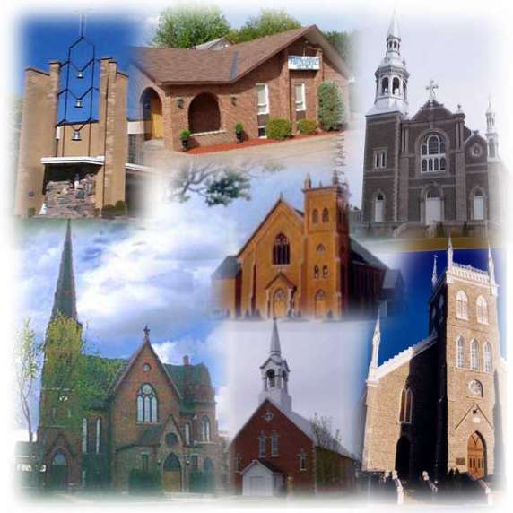
Some Crucial Tools for Putting and Keeping Us on the Right Pathway:
Certain Basic Starting Points and Assumptions:
The Resources Bequeathed to Us as a Part of Historically-extended Communities:
Nation(s):
Global Network(s):
Church(es):

Slide 24
Some Crucial Tools for Putting and Keeping Us on the Right Pathway:
Certain Basic Starting Points and Assumptions:
The Bible as the True, Authoritative, and Transformational Word of God:

Slide 25
Some Crucial Tools for Putting and Keeping Us on the Right Pathway:
The Bible: A Responsible Interpretive Framework (2 Timothy 3:16-17):
Observation:

Slide 26
Some Crucial Tools for Putting and Keeping Us on the Right Pathway:
The Bible: A Responsible Interpretive Framework (2 Timothy 3:16-17):
Observation:
Interpretation:

Slide 27
Some Crucial Tools for Putting and Keeping Us on the Right Pathway:
The Bible: A Responsible Interpretive Framework (2 Timothy 3:16-17):
Observation:
Interpretation:
Application:

Slide 28
Some Crucial Tools for Putting and Keeping Us on the Right Pathway:
A Sound Theological Method:
Basic Elements of Good Theology:
The Bible:

Slide 29
Some Crucial Tools for Putting and Keeping Us on the Right Pathway:
A Sound Theological Method:
Basic Elements of Good Theology:
The Bible:
Philosophy, Worldview, and Experience:

Slide 30
Some Crucial Tools for Putting and Keeping Us on the Right Pathway:
A Sound Theological Method:
Basic Elements of Good Theology:
The Bible:
Philosophy, Worldview, and Experience:
History and Community:

Slide 31
Some Crucial Tools for Putting and Keeping Us on the Right Pathway:
A Sound Theological Method:
Basic Elements of Good Theology:
The Bible:
Philosophy, Worldview, and Experience:
History and Community:
Rationality, Knowledge, Analysis, and Synthesis/Organization:

Slide 32
Some Crucial Tools for Putting and Keeping Us on the Right Pathway:
A Sound Theological Method:
Basic Elements of Good Theology:
Godliness:

Slide 33
Some Crucial Tools for Putting and Keeping Us on the Right Pathway:
A Sound Theological Method:
Basic Elements of Good Theology:
Godliness:
Humility/Teachability:

Slide 34
Some Crucial Tools for Putting and Keeping Us on the Right Pathway:
A Sound Theological Method:
Basic Elements of Good Theology:
Godliness:
Humility/Teachability:
A Life of Practiced Spiritual Disciplines:

Slide 35
Some Crucial Tools for Putting and Keeping Us on the Right Pathway:
A Sound Theological Method:
Basic Elements of Good Theology:
Godliness:
Humility/Teachability:
A Life of Practiced Spiritual Disciplines:
Intimacy with God:

Slide 36
Some Crucial Tools for Putting and Keeping Us on the Right Pathway:
A Sound Theological Method:
A Simplified Theological Method (IDEA):
Identify an issue and the various historical and contemporary approaches to it.

Slide 37
Some Crucial Tools for Putting and Keeping Us on the Right Pathway:
A Sound Theological Method:
A Simplified Theological Method (IDEA):
Identify an issue and the various historical and contemporary approaches to it.
Discover the biblical teaching on the issue in both Old and New Testaments.

Slide 38
Some Crucial Tools for Putting and Keeping Us on the Right Pathway:
A Sound Theological Method:
A Simplified Theological Method (IDEA):
Establish a theological summary and response to the issue.

Slide 39
Some Crucial Tools for Putting and Keeping Us on the Right Pathway:
A Sound Theological Method:
A Simplified Theological Method (IDEA):
Establish a theological summary and response to the issue.
Apply the truth you have discovered both personally and corporately.

Slide 40
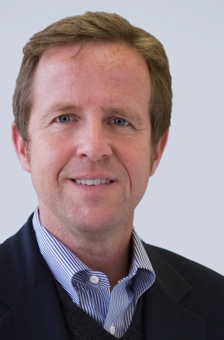
Worldview Workshop: Identifying Worldview Factors in Biblical Interpretation:
Every person has a philosophical outlook that . . . influences the way he or she reads the Bible. . . . It is an outlook that is either actively pursued or passively received by osmosis. If we naively assume that we are unaffected by our own context, we will miss the ways in which we are unfaithful to the biblical text because of our hidden prejudices.
Michael S. Horton, Where in the World Is the Church?, 69

Slide 41
Worldview Workshop: Identifying Worldview Factors in Biblical Interpretation:
When reading the Bible, always pay special attention to the following things:
When the Passage You Are Reading Is Confusing or Seems to Make Little or No Sense:

Slide 42
Worldview Workshop: Identifying Worldview Factors in Biblical Interpretation:
When reading the Bible, always pay special attention to the following things:
When the Passage You Are Reading Is Confusing or Seems to Make Little or No Sense:
When the Passage Seems Odd, Foreign, or Puzzling:

Slide 43
Worldview Workshop: Identifying Worldview Factors in Biblical Interpretation:
When reading the Bible, always pay special attention to the following things:
When the Passage You Are Reading Is Confusing or Seems to Make Little or No Sense:
When the Passage Seems Odd, Foreign, or Puzzling:
When the Passage Seems Obviously Right and True:

Slide 44
Worldview Workshop: Identifying Worldview Factors in Biblical Interpretation:
When reading the Bible, always pay special attention to the following things:
When the Passage Seems Boring or Irrelevant:

Slide 45
Worldview Workshop: Identifying Worldview Factors in Biblical Interpretation:
When reading the Bible, always pay special attention to the following things:
When the Passage Seems Boring or Irrelevant:
When the Passage Seems Ridiculous and Unbelievable:

Slide 46
Worldview Workshop: Identifying Worldview Factors in Biblical Interpretation:
When reading the Bible, always pay special attention to the following things:
When the Passage Seems Boring or Irrelevant:
When the Passage Seems Ridiculous and Unbelievable:
When the Passage Scandalizes, Offends, and/or Makes You or Others in the Culture Uncomfortable or Uneasy:

Slide 47
Worldview Workshop: Identifying Worldview Factors in Biblical Interpretation:
When reading the Bible, always pay special attention to the following things:
When the Passage Excites and Electrifies:

Slide 48
Worldview Workshop: Identifying Worldview Factors in Biblical Interpretation:
Some Possible Scriptural Examples to Help Illustrate the Idea:
Cultural Conundrums:

Slide 49
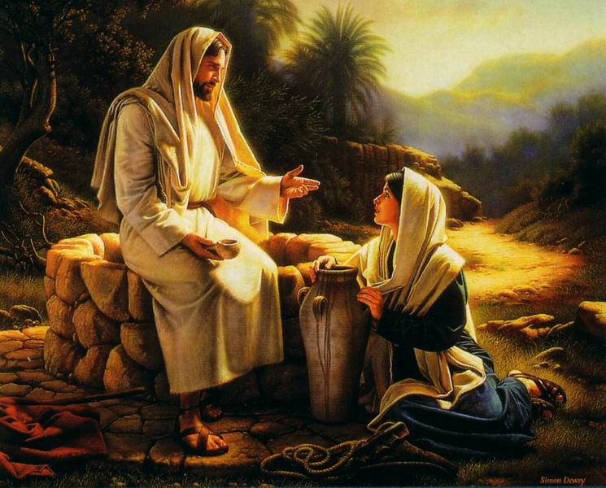
Worldview Workshop: Identifying Worldview Factors in Biblical Interpretation:
Some Possible Scriptural Examples to Help Illustrate the Idea:
Cultural Conundrums:
The Samaritan Woman at Jacob’s Well (John 4):

Slide 50
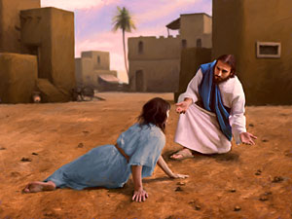
Worldview Workshop: Identifying Worldview Factors in Biblical Interpretation:
Some Possible Scriptural Examples to Help Illustrate the Idea:
Cultural Conundrums:
The Samaritan Woman at Jacob’s Well (John 4):
The Woman Caught in Adultery (John 8):

Slide 51
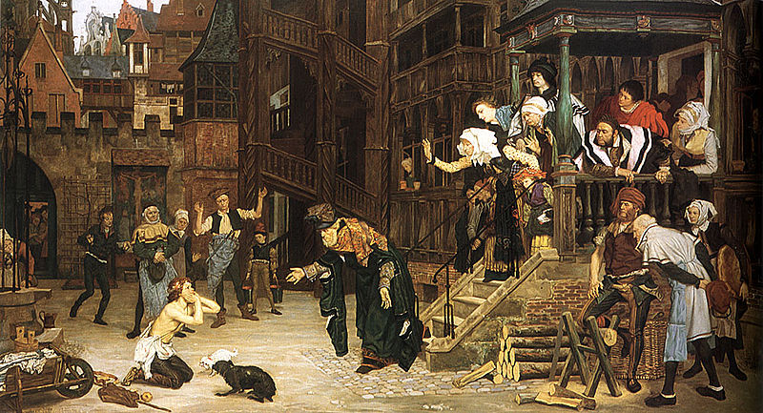
Worldview Workshop: Identifying Worldview Factors in Biblical Interpretation:
Some Possible Scriptural Examples to Help Illustrate the Idea:
Cultural Conundrums:
The Samaritan Woman at Jacob’s Well (John 4):
The Woman Caught in Adultery (John 8):
The Prodigal Son’s Older Brother (Luke 15):

Slide 52
Worldview Workshop: Identifying Worldview Factors in Biblical Interpretation:
Some Possible Scriptural Examples to Help Illustrate the Idea:
Ethical Issues:

Slide 53
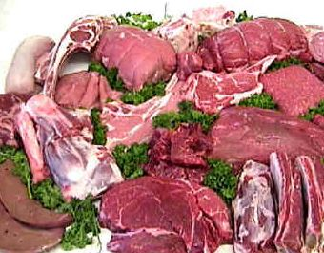
Worldview Workshop: Identifying Worldview Factors in Biblical Interpretation:
Some Possible Scriptural Examples to Help Illustrate the Idea:
Ethical Issues:
Meat Sacrificed to Idols (1 Corinthians 8):

Slide 54
Worldview Workshop: Identifying Worldview Factors in Biblical Interpretation:
Some Possible Scriptural Examples to Help Illustrate the Idea:
Ethical Issues:
Meat Sacrificed to Idols (1 Corinthians 8):
Prayer and Women’s Head-Coverings (1 Corinthians 11):

Slide 55
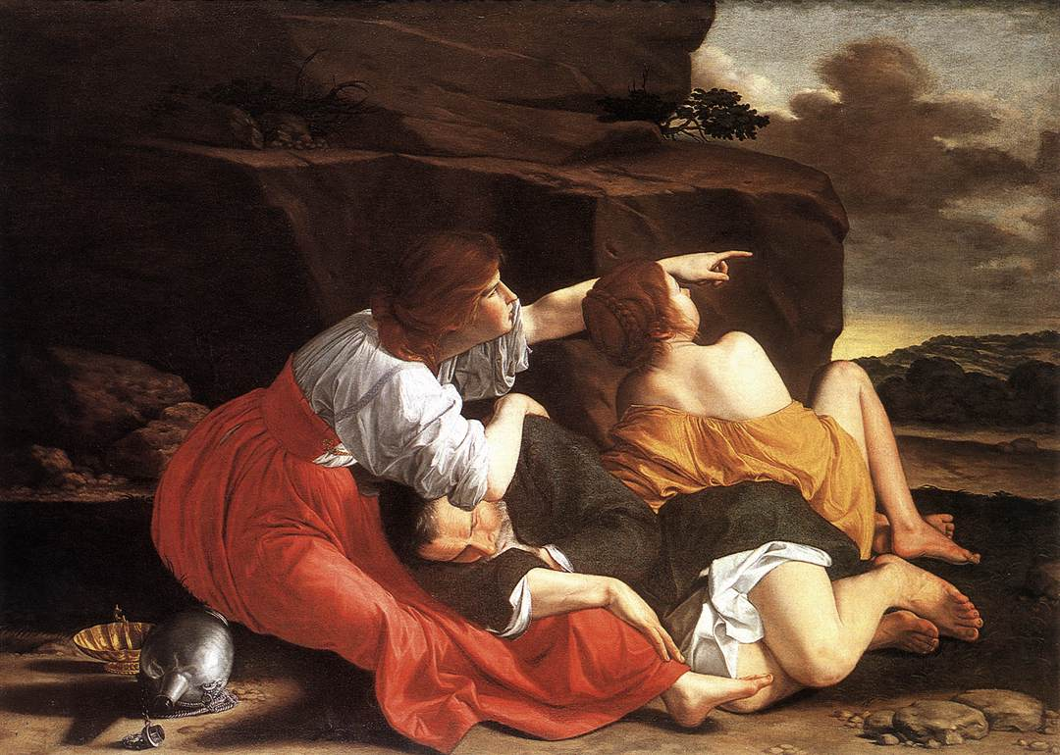
Worldview Workshop: Identifying Worldview Factors in Biblical Interpretation:
Some Possible Scriptural Examples to Help Illustrate the Idea:
Ethical Issues:
The Incest of Lot’s Daughters (Genesis 19):

Slide 56
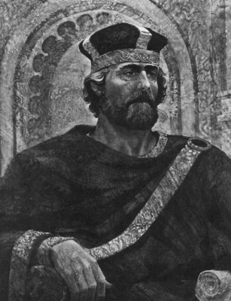
Worldview Workshop: Identifying Worldview Factors in Biblical Interpretation:
Some Possible Scriptural Examples to Help Illustrate the Idea:
Ethical Issues:
The Incest of Lot’s Daughters (Genesis 19):
Polygamy among the Kings of the Old Testament:

Slide 57
Worldview Workshop: Identifying Worldview Factors in Biblical Interpretation:
Some Possible Scriptural Examples to Help Illustrate the Idea:
Sources of Authority:

Slide 58
Worldview Workshop: Identifying Worldview Factors in Biblical Interpretation:
Some Possible Scriptural Examples to Help Illustrate the Idea:
Sources of Authority:
The Genealogies of Jesus (Matthew 1; Luke 3):

Slide 59
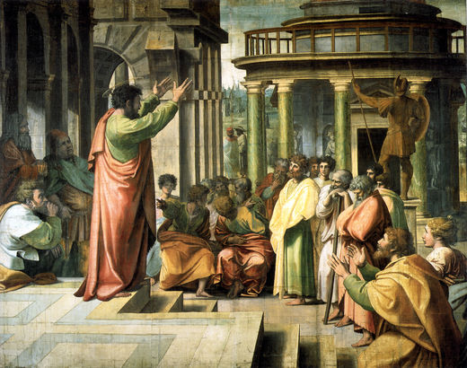
Worldview Workshop: Identifying Worldview Factors in Biblical Interpretation:
Some Possible Scriptural Examples to Help Illustrate the Idea:
Sources of Authority:
The Genealogies of Jesus (Matthew 1; Luke 3):
Paul’s Sermons in Acts 13 and Acts 17:

Slide 60
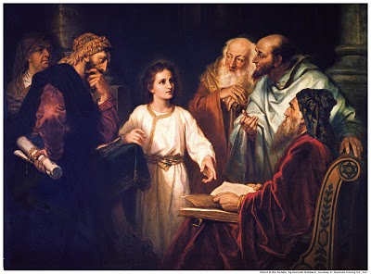
Worldview Workshop: Identifying Worldview Factors in Biblical Interpretation:
Some Possible Scriptural Examples to Help Illustrate the Idea:
Theological Significances:
Jesus at Age 12 at the Temple (Luke 2):

Slide 61
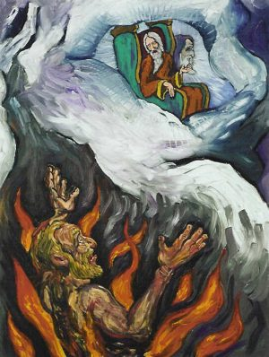
Worldview Workshop: Identifying Worldview Factors in Biblical Interpretation:
Some Possible Scriptural Examples to Help Illustrate the Idea:
Theological Significances:
Jesus at Age 12 at the Temple (Luke 2):
The Parable of the Rich Man and Lazarus (Luke 16):

Slide 62
Black

Slide 63
Worldview link at BibleStudyDownloads.org
Get this presentation for free!
Notes:
WV (Worldviews)

